Slide 1

nVision
An algorithm for seizure detection in rodents
Kamintsky L, van Hameren G, Weissberg I, Moradi P, Prager O, Ahmad AA, et al. An algorithm for seizure detection in rodents. Epilepsia Open. 2025; 00: 1–13. https://doi.org/10.1002/epi4.70070

Slide 2
Table of contents
Installation
Main graphical user interface
Input signal requirements
Importing data
Data viewer
Selecting a quiet zone
Detecting seizure-like events
Results
Troubleshooting
Contact us

Slide 3
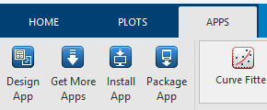
Installation
nVision is a graphical user interface built using MATLAB code. To run it, a valid up-to-date installation of MATLAB is required. In addition, the following toolboxes are required:
Signal processing
Deep learning
Statistics and Machine Learning
Toolboxes can be installed by clicking App > Get More Apps

Slide 4
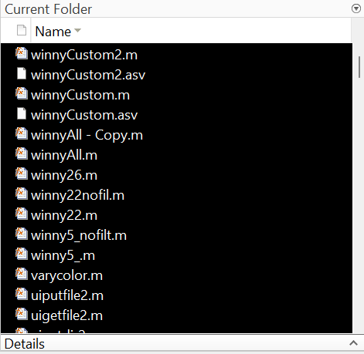
Installation
nVision can then be downloaded from the GitHub link below:
https://github.com/Hamza-Dal/nVision-SeizureDetection.git
Ensure that the files are unzipped and that current working directory in MATLAB is set to the nVision folder
Locate and double click on the script titled:
nvision2013_parameters_5_vs_26_g_new
The Current Folder should look like this

Slide 5
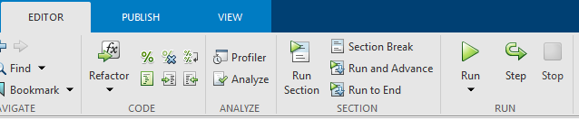
Main graphical user interface
To run nVision, navigate to Editor then click Run

Slide 6
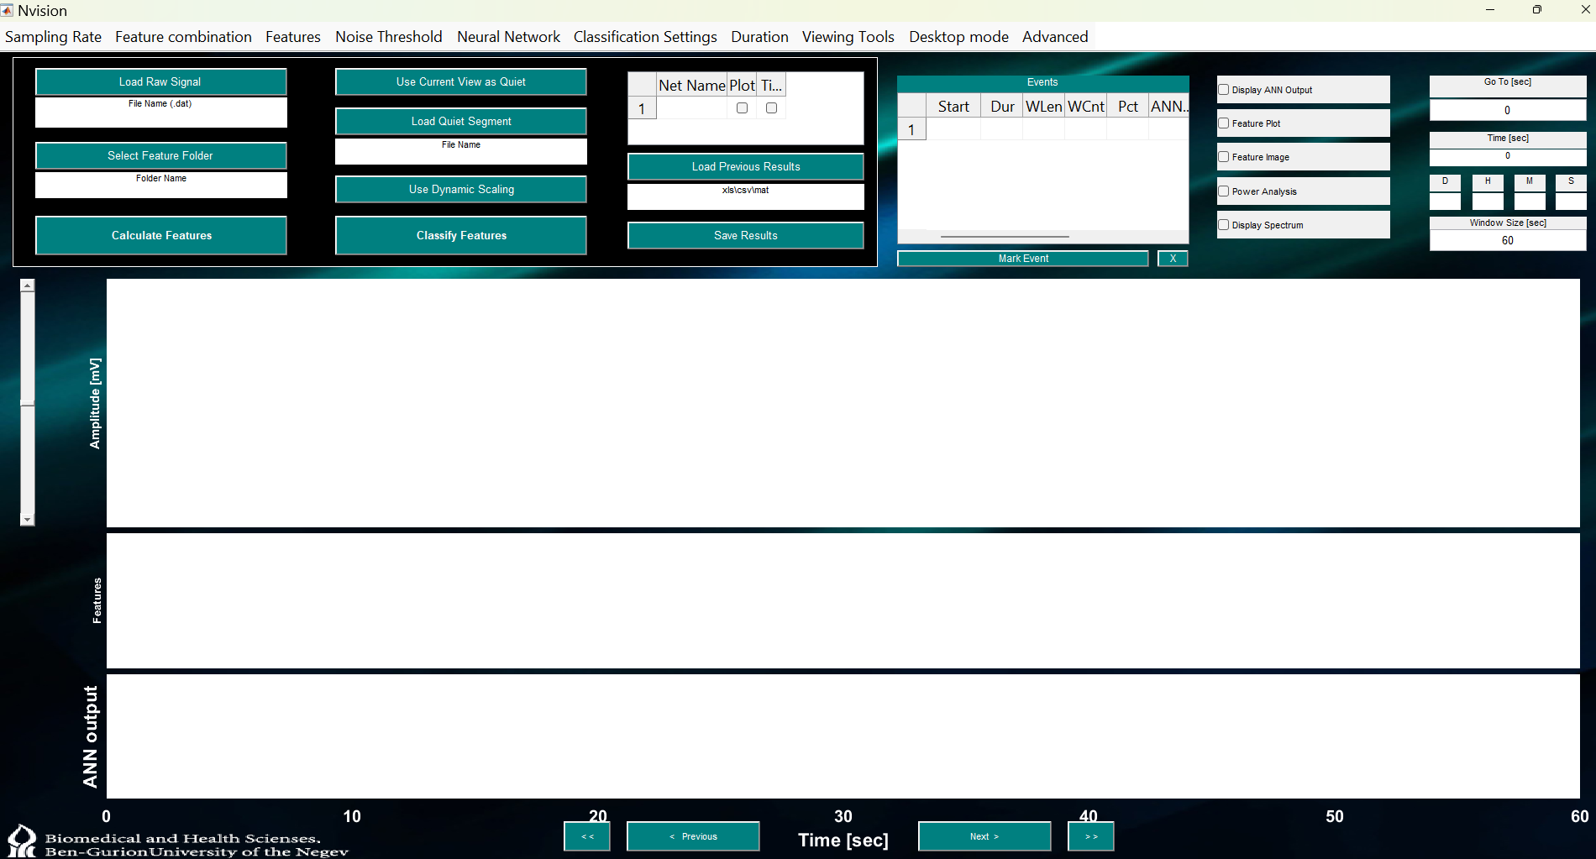
Main graphical user interface
The main graphical user interface (GUI) should now appear

Slide 7
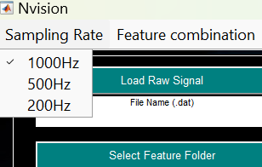
Input signal requirements
Data should contain minimal noise and in millivolt range
Sampling frequency should be 1000, 500 or 200 Hz
Signal filetype should be .dat
Edf files can be converted using edf2dat_updated.m
Sampling frequency can be selected from the menu bar

Slide 8
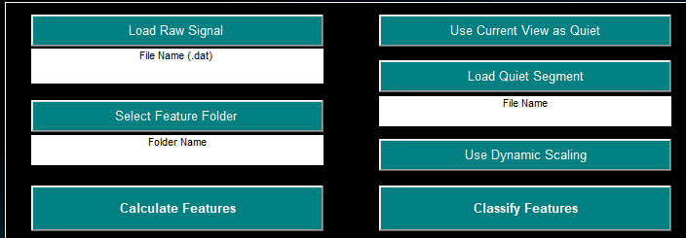
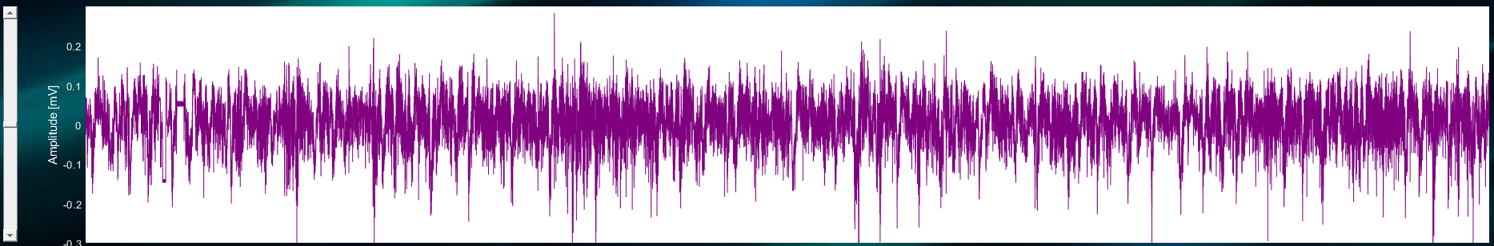
Importing data
Click Load Raw Signal
Select the .dat file to analyze
Adjust amplitude (optional)
Sample signal loaded into nVision

Slide 9
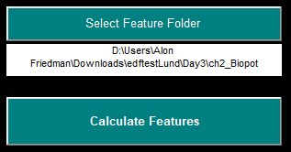
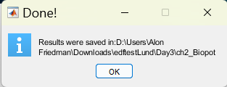
Select feature folder
Click Select Feature Folder
Create a new folder then select it
Click Calculate Features
This step might take some time
A pop-up will appear when its completed

Slide 10
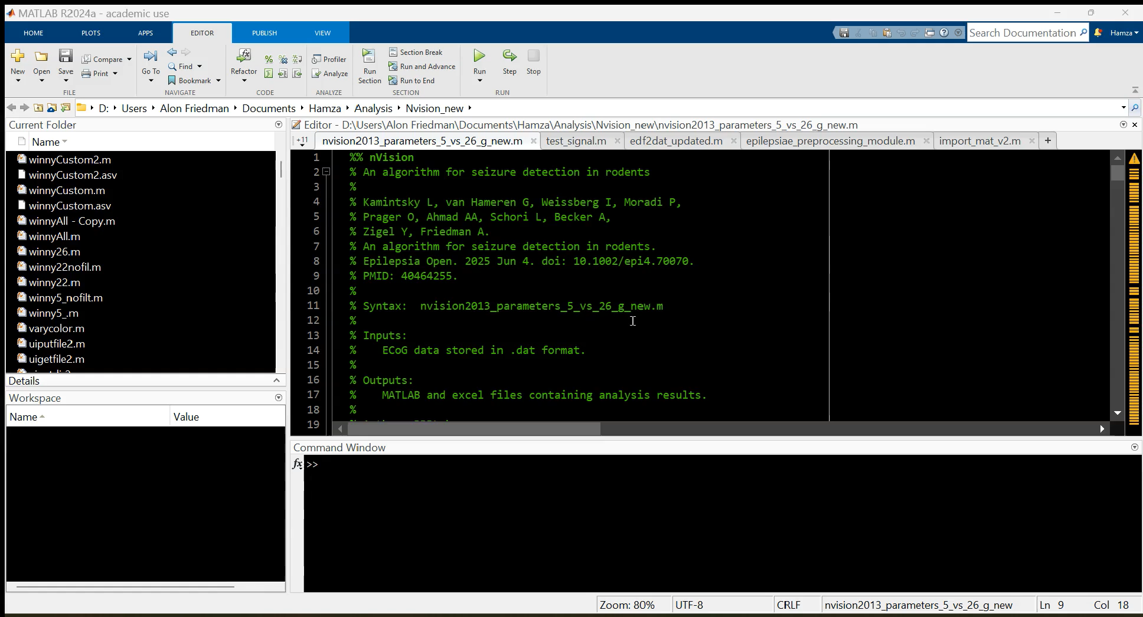
Loading signal and calculating features

Slide 11
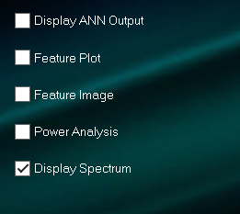
Data viewer
The data can be viewed to inspect model output and signal derived features.
The following options are available:
Display ANN output: Displays the ANN score for the selected data segment
Feature Plot: Shows the individual features contributing to the ANN score
Feature Image: Visualizes the features as a spectrogram
Power Analysis: Displays the signal power spectral distribution
Display Spectrum: Spectrogram of the signal segment

Slide 12
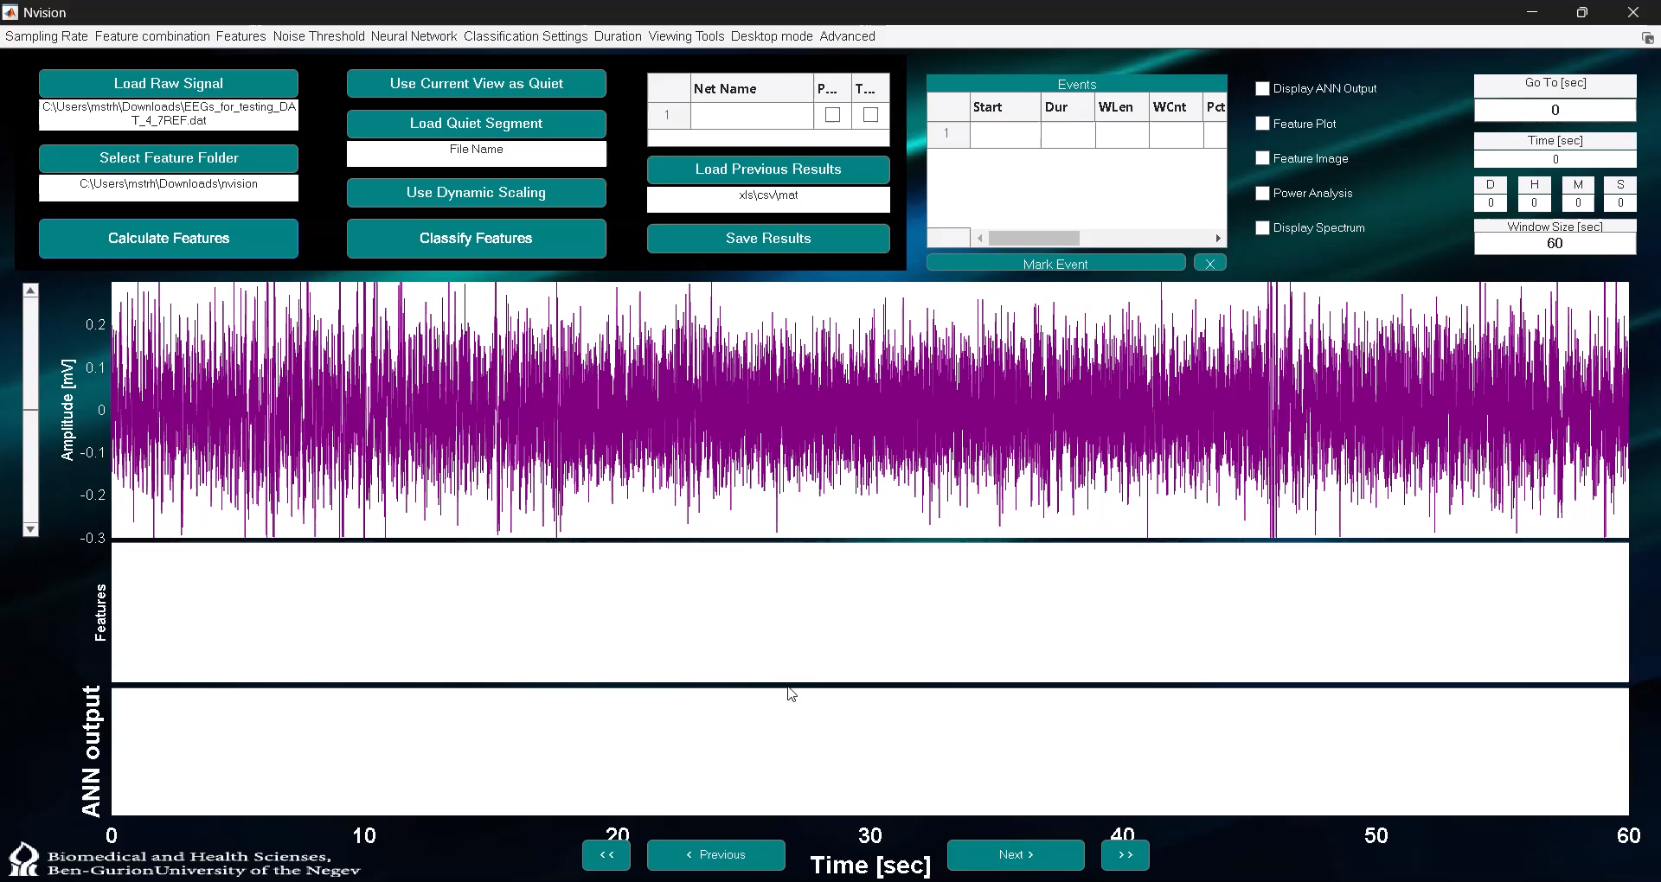
Data viewer

Slide 13
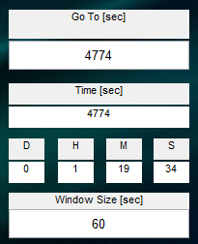
Selecting a quiet zone
Use the buttons on the bottom or the inputs on the right to navigate to a quiet zone.
The quiet zone should represent a segment in the recording where there isn’t epileptiform activity and little noise.
The features of this zone will be used to characterize the individual recording and detect seizure like events (helps to normalize for the noise level in each specific recording).
GUI elements used to navigate the recording

Slide 14
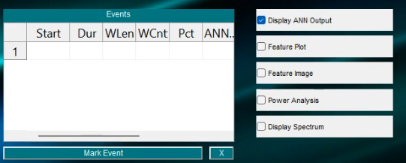
The ANN score can help identify a quiet zone
Click ANN Output
This will display the ANN output in the GUI
A quiet zone will have relatively low ANN score throughout the quiet zone segment
Sample quiet zone with low ANN

Slide 15
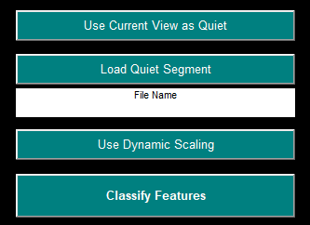
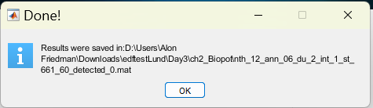
Detecting seizure like events
Once the quiet zone is selected, click Classify Features
nVision will now look for seizure like events, using the quiet zone as reference for its ANN network
This step may take some time
A pop-up will appear when this step is done

Slide 16
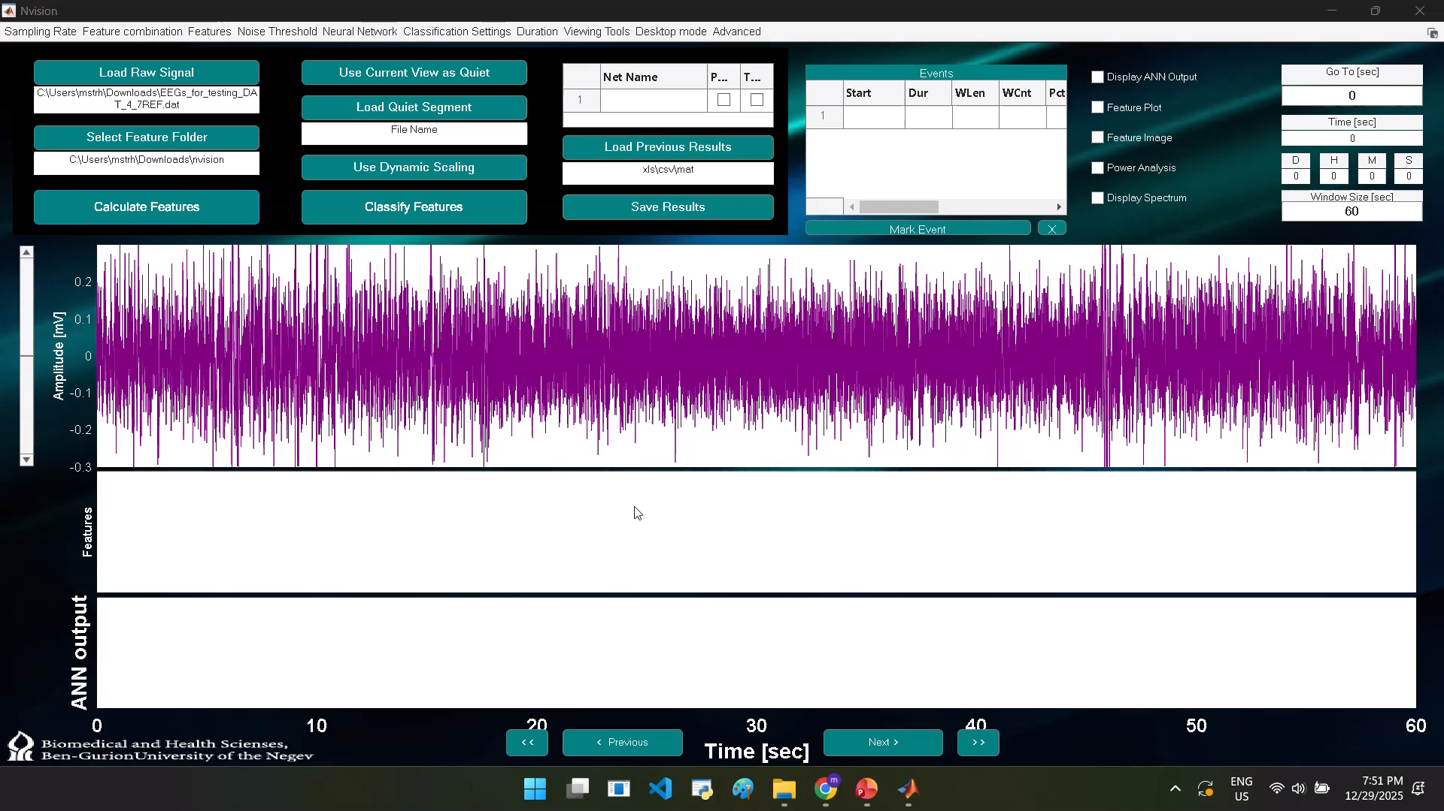
Detecting seizure like events

Slide 17
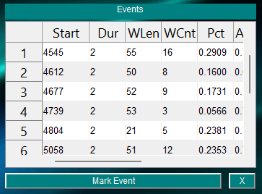
Results
Results are automatically saved as a .mat file in the same folder where the recording is stored
They also appear in the GUI
Clicking on the events will navigate the display to the detected event
Results can be marked or deleted within the GUI environment
Click Save Results to generate a new .mat file
Example seizure like events

Slide 18
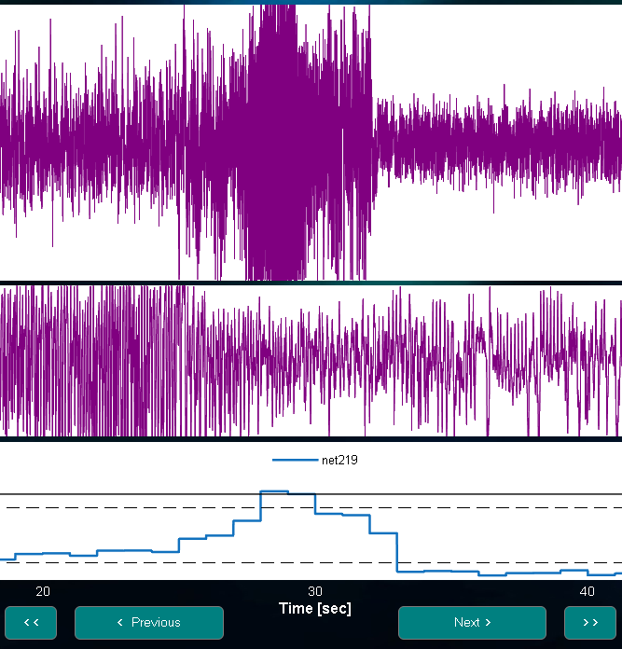
Seizure Detection Criterion
A seizure like event is detected when the ANN output exceeds the predefined ANN threshold for a specified minimum duration

Slide 19
Troubleshooting
nVision detects seizure-like events by comparing the quiet zone features to the rest of the recording using an artificial neural network
If no events were detected, try using a different quiet zone or adjusting features/thresholds of the algorithm
Algorithm features and thresholds can be adjusted using the menu bar at the top of the GUI

Slide 20
Troubleshooting
In noisy recordings you may detect many “false positive” events. In such cases, the seizure like event duration can be changed, ANN threshold can be adjusted, or multiple quiet zones can be selected.
Seizure-like events that overlap across quiet zones have a high probability of being classified as seizure-like events, as their feature characteristics closely resemble those of seizures used to train the ANN.

Slide 21

Contact us
Correspondance to
Alon Friedman, MD, PhD
Professor of Neuroscience
Dennis Chair in Epilepsy Research
Departments of Medical Neuroscience, Surgery and Pediatrics,
Faculty of Medicine, Dalhousie University
Halifax, NS
Email
Alon.Friedman@dal.ca
bbbscience.com

